Slide 1
Audieyes: Enhancing Visual Accessibility through Advanced AI Technologies.
Ayoub Maimmadi

Slide 2
Agenda
Introduction
Project Overview
Technical Framework
Implementation Details
Deployment and Operations
ML System Architecture
Future Directions & Conclusion

Slide 3

Introduction
Notes:
Audieyes is an innovative solution designed to enhance visual accessibility for the visually impaired community. Leveraging cutting-edge AI technologies, Audieyes aims to provide intuitive and efficient assistance to those with visual impairments, significantly improving their daily lives.
Our project combines advanced image recognition, real-time navigation assistance, and personalized user experiences to create a comprehensive tool that addresses the unique challenges faced by the visually impaired. Through thoughtful design and user-centric development, Audieyes not only fulfills a vital social need but also explores a market with significant growth potential.

Slide 4

Project Overview
Problem Statement
Business Case and Metrics
Notes:
Despite significant advancements in technology, the visually impaired community often encounters barriers to accessibility and independence. From challenges in identifying clothing and colors to navigating unfamiliar environments and accessing printed materials, the need for comprehensive, user-friendly solutions is evident. Audieyes seeks to address these challenges head-on, leveraging cutting-edge technology to provide practical, empowering solutions.

Slide 5
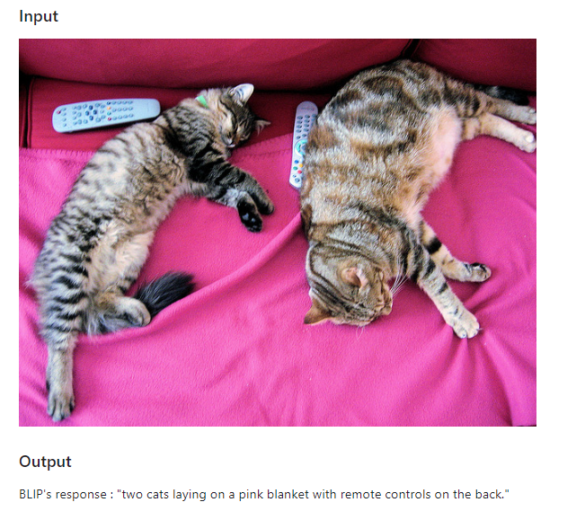
Leveraging ML &
Architectural Archetypes
1. Human-in-the-Loop (HITL) for Enhanced Accuracy
2. Privacy-First Design in Image Processing
3. Autonomous Real-Time Captioning
4. Integration with Broader Ecosystems
Notes:
Leveraging machine learning, Audieyes enhances its core functionalities, offering personalized experiences and improving the accuracy and efficiency of its features. ML drives the project's innovative edge, from image recognition to predictive analytics for navigation.
Human-in-the-Loop (HITL) for Enhanced Accuracy:
HITL integrates human feedback to improve caption accuracy. Users can request more details, refining AI models to better meet diverse needs.
Privacy-First Design in Image Processing:
Audieyes prioritizes data protection by encrypting user data and ensuring compliance with privacy laws and ethical standards.
Autonomous Real-Time Captioning:
AI-driven vision captioning provides real-time descriptions of images and video, offering immediate insights into complex scenes and objects.
Integration with Broader Ecosystems for Comprehensive Support:
The vision captioning system integrates with other Audieyes features like navigation aids and text-to-speech, providing comprehensive support for users.

Slide 6
Business Case
Business Metrics
1. Market Expansion:
2. Brand Differentiation.
3. Operational Efficiency:
4. Customer Loyalty and Retention:
5. Data-Driven Insights for Product Development: .
The Audieyes project presents a compelling business case by addressing a critical and underserved market: the accessibility needs of the visually impaired community. Through innovation and user-centric design, Audieyes not only fulfills a social imperative but also taps into a market with significant growth potential.
Notes:
"This slide presents the compelling business case for the Audieyes project, focusing on addressing the accessibility needs of the visually impaired community.
Problem Statement:
The Audieyes project tackles a critical and underserved market, providing innovative solutions to enhance the lives of visually impaired individuals.
Business Metrics:
Market Expansion: By catering to a niche yet significant market, Audieyes has the potential for substantial market growth.
Brand Differentiation: Offering unique, user-centric design and functionality sets Audieyes apart from competitors.
Operational Efficiency: Leveraging advanced AI technologies improves the efficiency and accuracy of our services.
Customer Loyalty and Retention: Providing valuable, reliable solutions fosters customer loyalty and retention.
Data-Driven Insights for Product Development: Continuous data collection and analysis drive informed decisions for product enhancements and innovation.
Through innovation and a strong focus on user needs, Audieyes not only fulfills a social imperative but also taps into a market with significant growth potential."

Slide 7
Implementation Details
ML Pipeline Development
From Monolith to MLOps Pipeline
MLflow for Experiment Tracking
Meta Store Setup
All other technologies
ML System Architecture

Slide 8
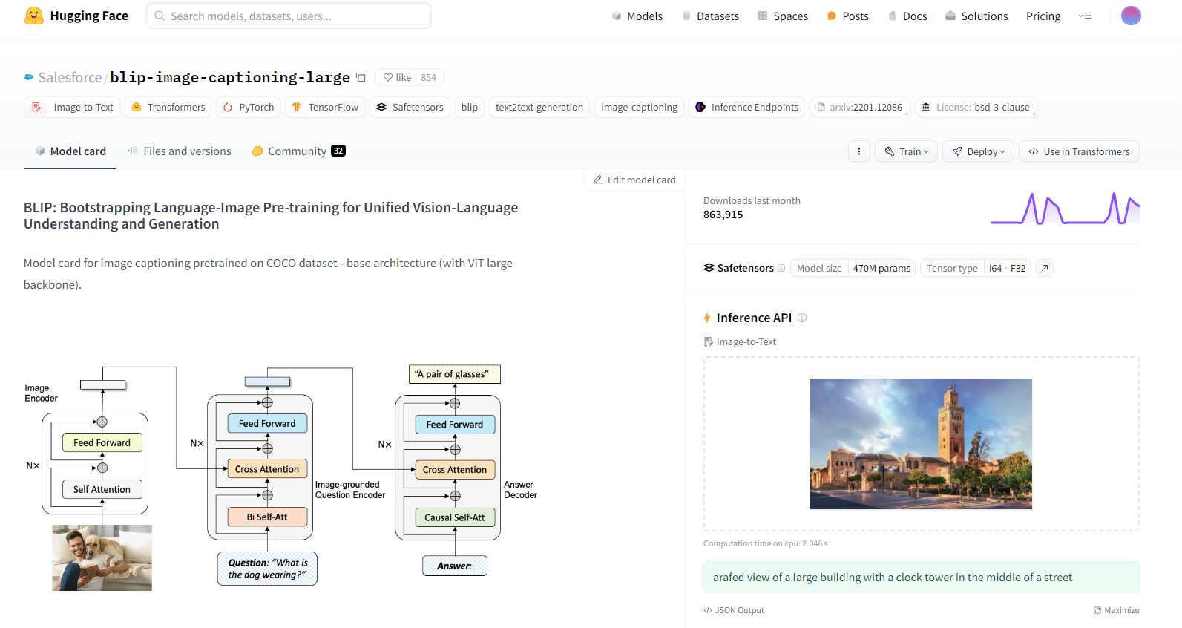
Model choice
Notes:
"This slide explains my choice of model for the Audieyes project.
BLIP (Bootstrapping Language-Image Pre-training):
We selected the BLIP model for its advanced vision-language understanding capabilities.
Pre-trained on the COCO dataset, it uses a Vision Transformer (ViT) backbone for robust image captioning.
The architecture combines self-attention and cross-attention mechanisms to generate accurate and relevant captions.
Key Features:
Image Encoder: Processes the image and extracts features.
Question Encoder: Grounds the image with text-based questions for better context.
Answer Decoder: Produces captions based on the combined inputs.
BLIP's architecture ensures high-quality, contextual image captions, making it ideal for enhancing visual accessibility in Audieyes."

Slide 9
From a Monolith to a Pipeline
Project structure definition and modularity
Code Versioning
Data & data versioning & Metadata Store
Experiment tracking and model versioning
Setting up the machine learning pipeline & tests
Deployment and Operations

Slide 10

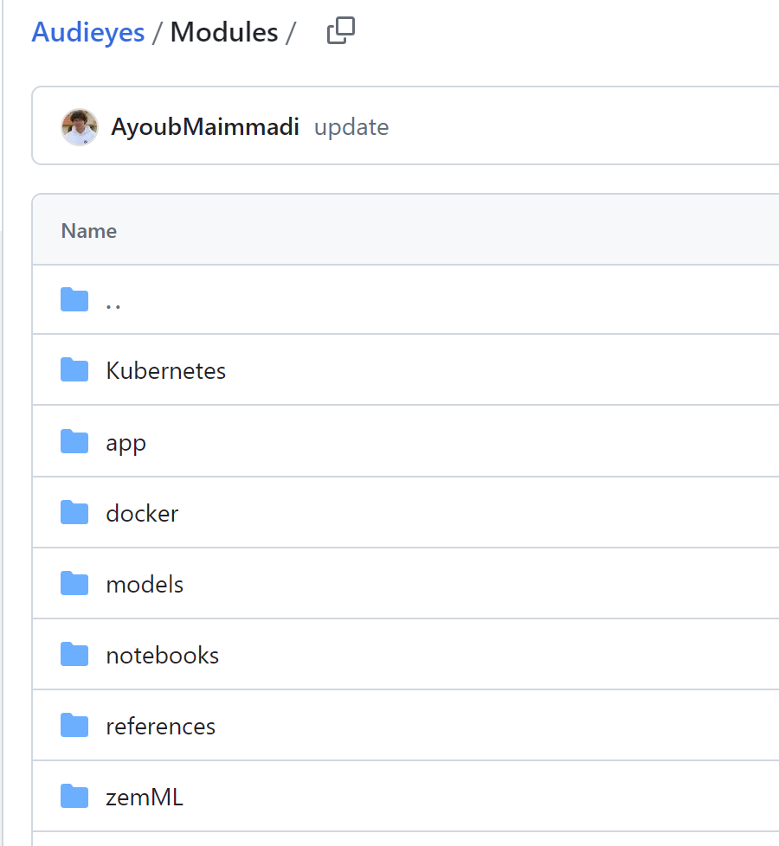
Project structure and modularity
Notes:
"On this slide, we'll discuss the importance of defining a clear project structure and ensuring modularity.
Project Structure Definition:
Establishing a well-organized project structure is crucial for maintainability and scalability.
It allows for easier navigation, better collaboration, and more efficient troubleshooting.
Modularity:
Breaking down the project into smaller, independent modules increases flexibility.
Each module can be developed, tested, and deployed independently, leading to faster development cycles.
Modularity also facilitates reusability, making it simpler to integrate new features or update existing ones.
By implementing a structured and modular approach, we ensure that our project remains robust, adaptable, and scalable."

Slide 11


Code
Versioning
Notes:
"This slide highlights the tools we use for code versioning, crucial for maintaining code integrity and enabling collaboration.
GitHub:
We use GitHub for managing our source code. It provides robust version control, enabling us to track changes, collaborate with team members, and manage multiple versions of our codebase effectively.
DockerHub:
For containerized applications, DockerHub is our repository for storing and sharing Docker images. This allows us to version and distribute our application environments consistently across different stages of development and deployment.
Utilizing these tools ensures that our development process is streamlined, reliable, and efficient."

Slide 12
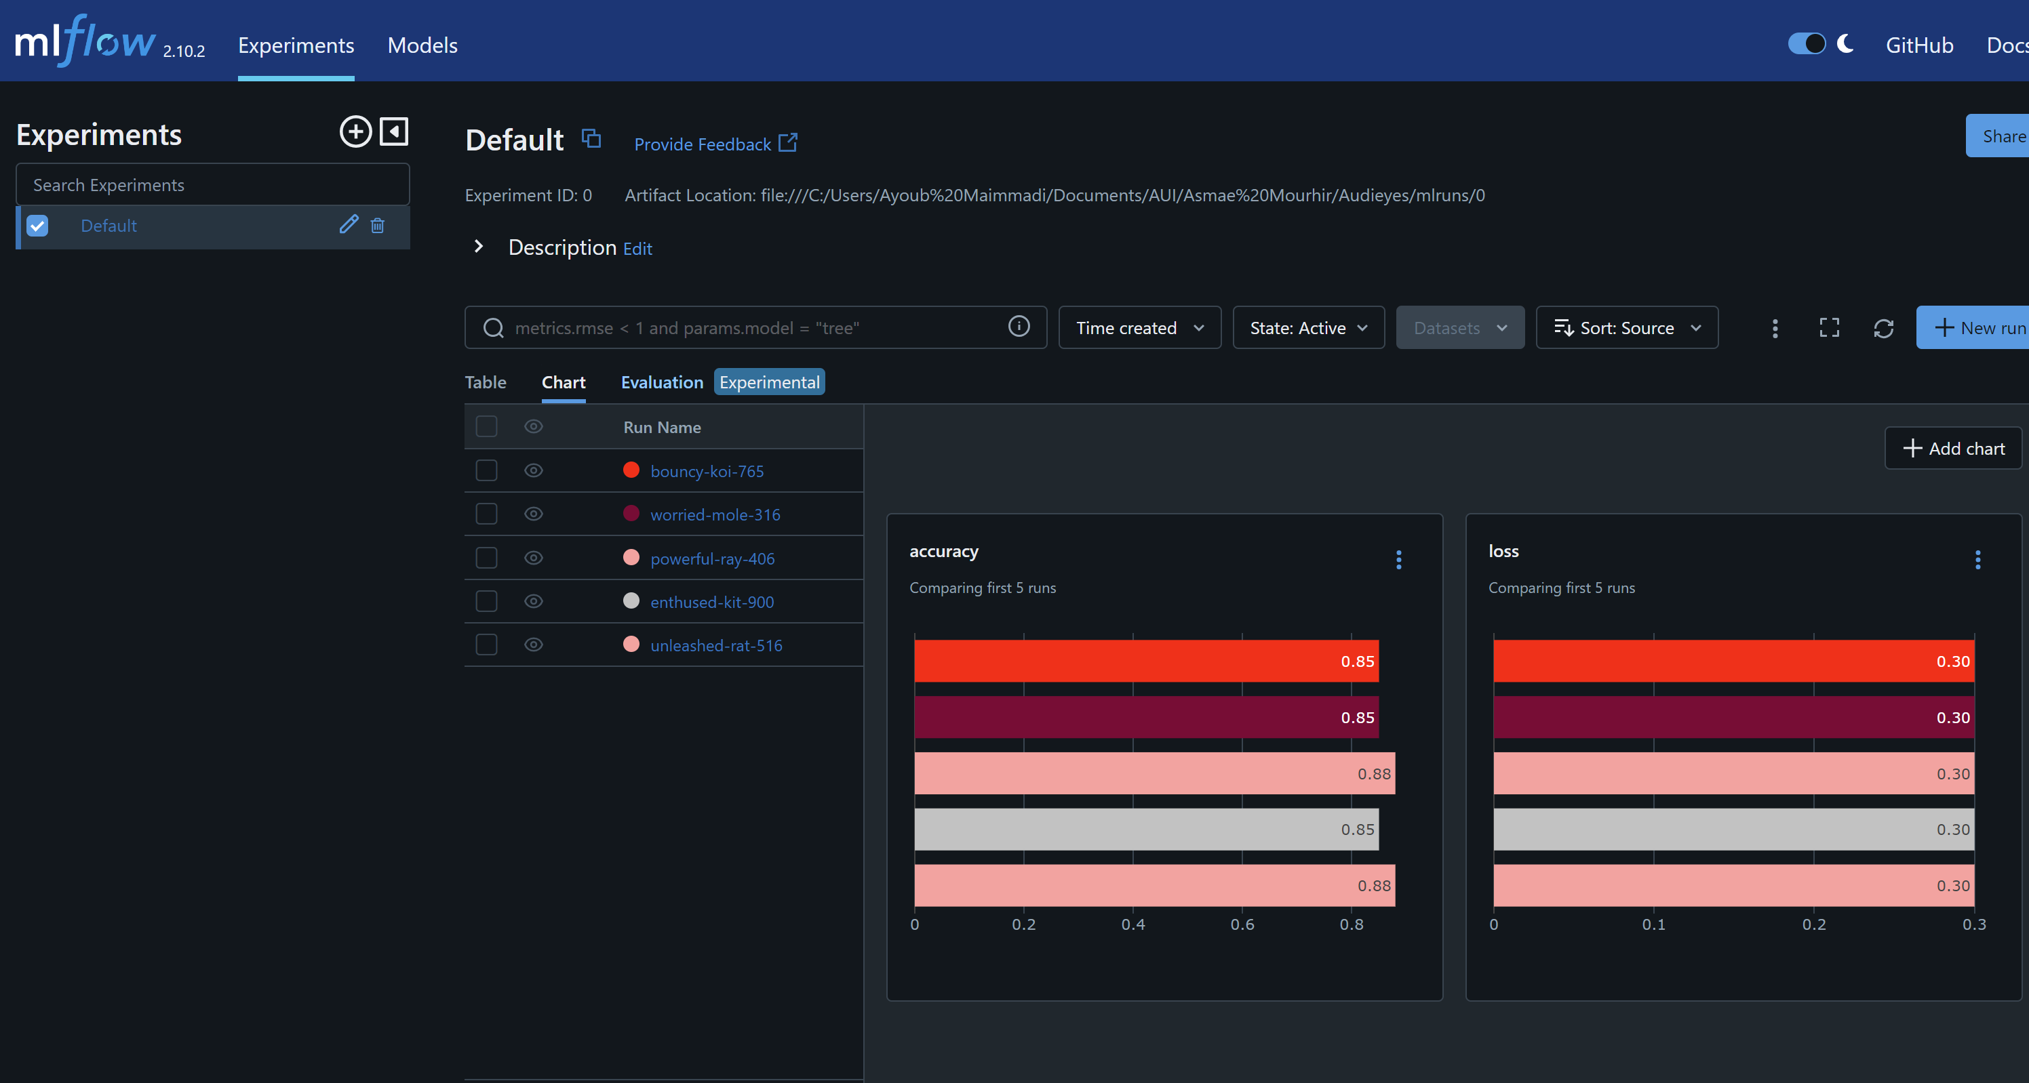
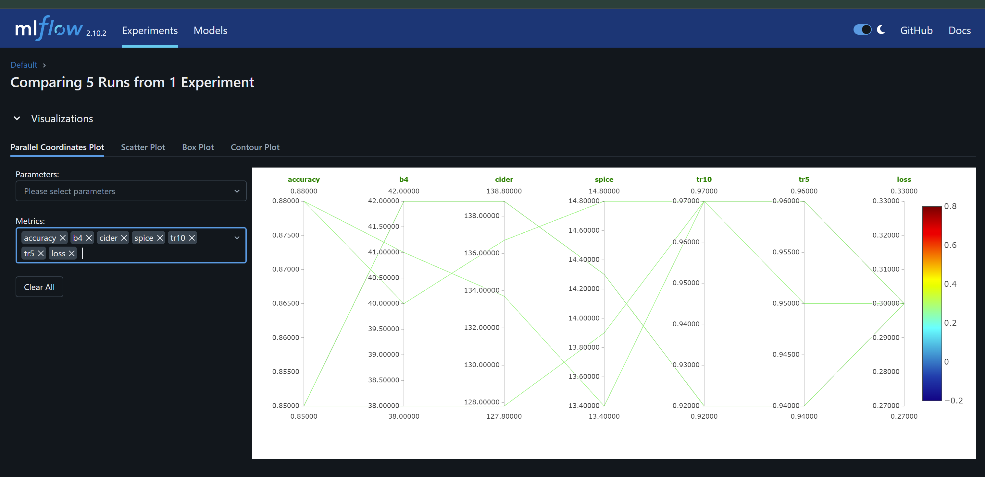
Experiment tracking and model versioning
Notes:
"This slide focuses on our approach to experiment tracking and model versioning, crucial for maintaining accuracy and efficiency in our machine learning workflows.
Experiment Tracking:
We utilize MLflow to track experiments. This allows us to record and compare multiple runs, capturing essential metrics and parameters for each experiment. This detailed tracking helps in understanding the impact of different changes and improvements over time.
Model Versioning:
MLflow also enables model versioning, allowing us to manage different versions of our models systematically. We can easily revert to previous versions if needed, ensuring stability and reliability in our deployment process.
These practices ensure that our machine learning models are developed, tested, and deployed with precision and accountability."

Slide 13

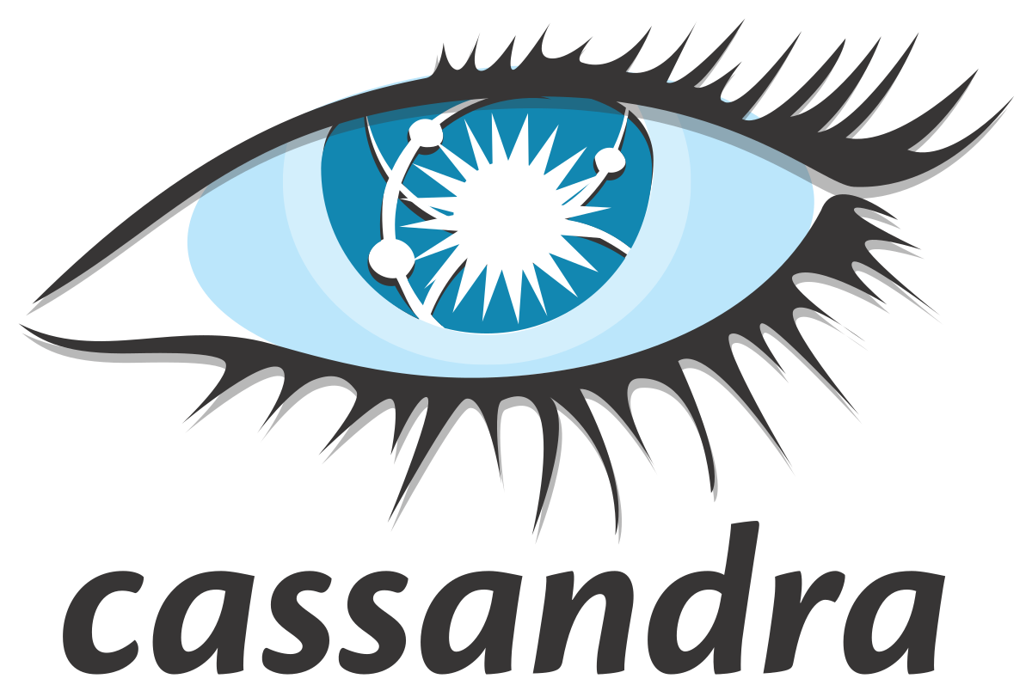
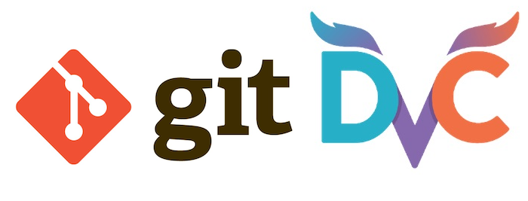
Data & data versioning & Metadata Store
Notes:
"This slide focuses on how we manage data, its versions, and the associated metadata, which is critical for ensuring consistency and reliability in our machine learning workflows.
Cassandra and MongoDB:
We use Cassandra and MongoDB to handle large-scale data storage. These databases are chosen for their scalability and high performance, allowing us to store and retrieve data efficiently.
Git and DVC:
Git, combined with Data Version Control (DVC), helps us manage data versioning. Just like code, our data and models are versioned, enabling us to track changes, revert to previous states, and ensure reproducibility of our experiments.
By leveraging these tools, we ensure our data management processes are robust, scalable, and efficient, laying a strong foundation for our machine learning pipeline."

Slide 14
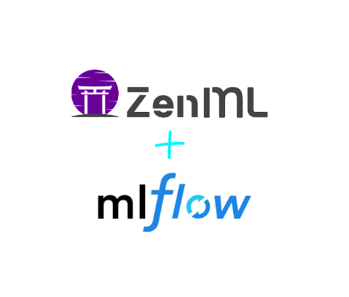
Setting up the machine learning pipeline
Notes:
"This slide illustrates the setup of our machine learning pipeline, which is integral to streamlining our ML processes.
ZenML:
ZenML serves as our orchestrator for creating reproducible ML pipelines. It enables us to automate the entire workflow from data ingestion to model deployment, ensuring consistency and reliability.
MLflow:
MLflow complements ZenML by managing the lifecycle of our machine learning models. It handles experiment tracking, model versioning, and deployment, providing a comprehensive suite of tools for ML development.
Together, ZenML and MLflow form a robust pipeline, enhancing our ability to develop, track, and deploy machine learning models efficiently and effectively."

Slide 15

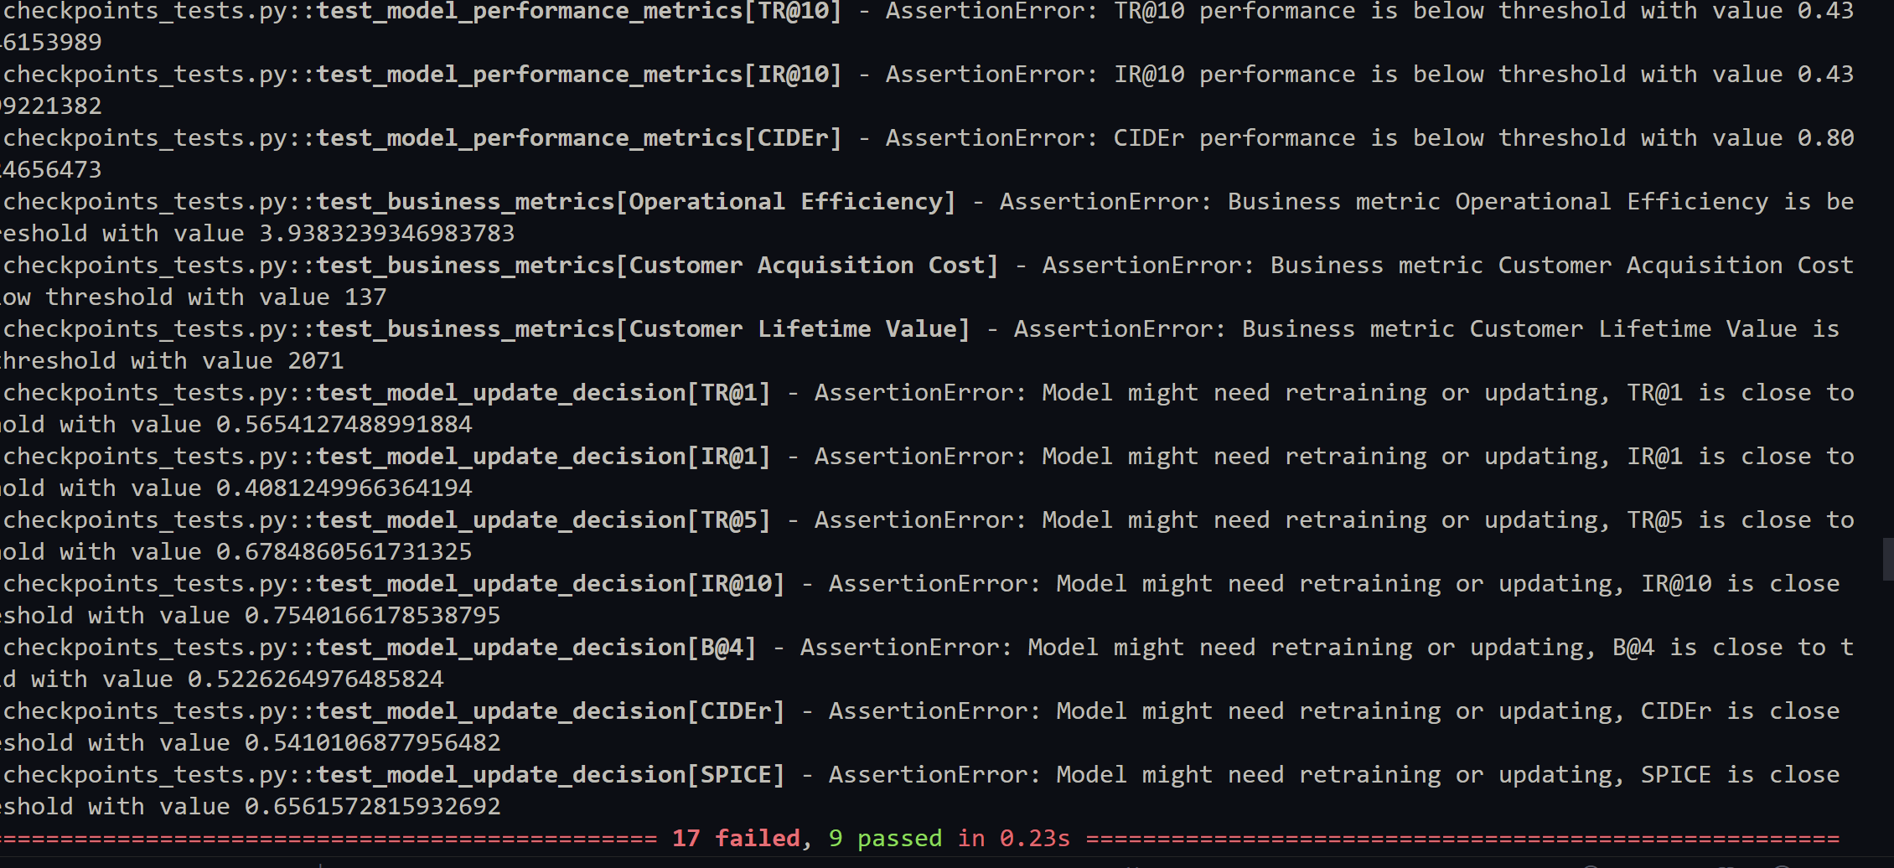
Behavioural model tests
Notes:
"This slide highlights our approach to behavioural model testing, which ensures the robustness and reliability of our machine learning models.
Pytest:
We use Pytest for automating our model tests. This includes testing performance metrics, business metrics, and decision thresholds to ensure our models are meeting the required standards.
Test Coverage:
The displayed output shows a series of behavioural tests, such as performance metrics (e.g., TR@10, IR@10) and business metrics (e.g., Operational Efficiency, Customer Acquisition Cost).
Any failed tests indicate areas where the model does not meet the predefined criteria and may require retraining or adjustments.
By implementing comprehensive behavioural tests, we ensure that our models perform optimally and align with our business goals and user expectations."

Slide 16


Resource & performance monitoring
Notes:
"This slide focuses on the tools we use for resource and performance monitoring, which are critical for maintaining the health and efficiency of our systems.
Grafana:
Grafana is our go-to tool for monitoring and visualizing system performance metrics. It provides real-time insights into resource usage, helping us identify and address any potential issues promptly.
Evidently AI:
Evidently AI is used for monitoring the performance of our machine learning models. It allows us to track metrics such as accuracy, drift, and other key indicators, ensuring our models remain effective and reliable over time.
By leveraging these tools, we ensure continuous monitoring and optimization of both system resources and model performance, leading to a more robust and efficient operation."

Slide 17
Deployment and Operations
Service
Model Service Deployment
Client
Front-end Client using React
Strategies
Model Deployment Strategies
Docker, Linode, and Kubernetes
Notes:
"This slide outlines our approach to deployment and operations, which ensures our models and applications are effectively delivered and maintained.
Service:
We focus on the deployment of model services, ensuring that our machine learning models are available and accessible for use in various applications.
Client:
The front-end client is developed using React. This modern, responsive framework ensures a seamless user experience and efficient interaction with our back-end services.
Strategies:
We employ several model deployment strategies, leveraging Docker for containerization, Linode for cloud hosting, and Kubernetes for orchestration and scalability. These tools and platforms enable us to deploy and manage our applications efficiently, ensuring reliability and performance.
By integrating these elements, we achieve a robust and scalable deployment process, facilitating smooth operations and user satisfaction."

Slide 18

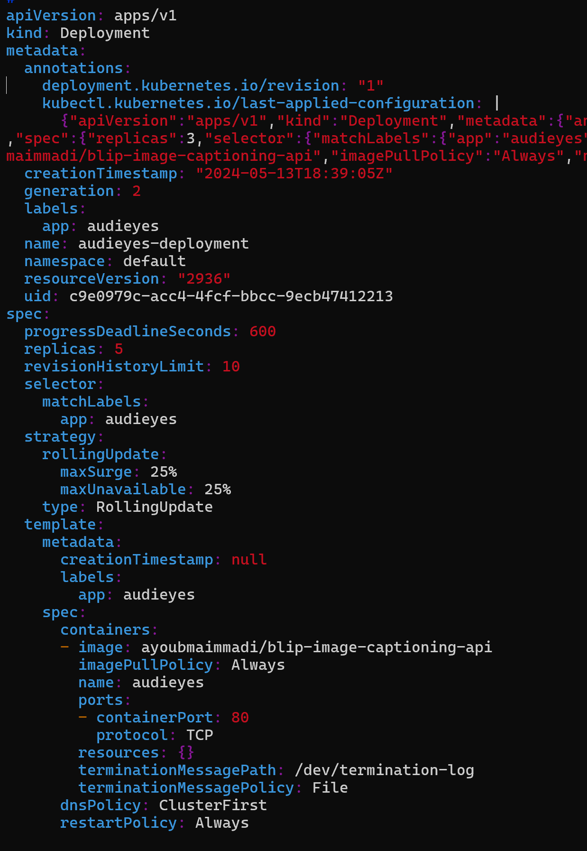
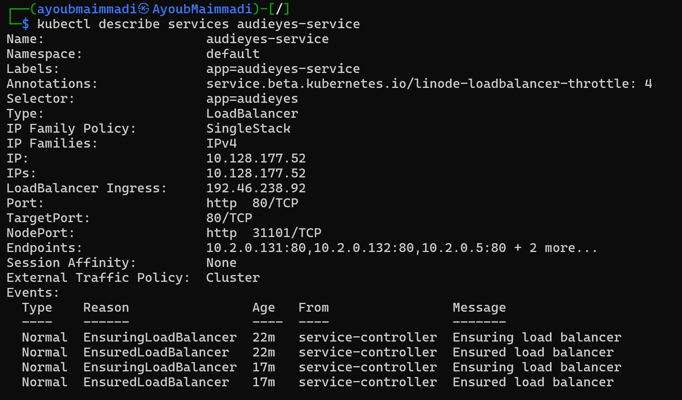
Deployment & serving
Notes:
"This slide showcases our deployment and serving strategy using Kubernetes.
Kubernetes:
Kubernetes orchestrates the deployment, scaling, and management of our containerized applications. It ensures our services are highly available and can handle varying loads efficiently.
Deployment Configuration:
The configuration on the left shows our Kubernetes deployment setup. We define the number of replicas, rolling update strategy, and container specifications to ensure smooth and reliable deployments.
Service Description:
On the right, we have the service description, detailing how the application is exposed and accessed. It includes information about the load balancer, IP addresses, and ports used to ensure our application is reachable and performant.
By leveraging Kubernetes, we achieve a robust and scalable deployment architecture, ensuring high availability and efficient resource management for our applications."

Slide 19
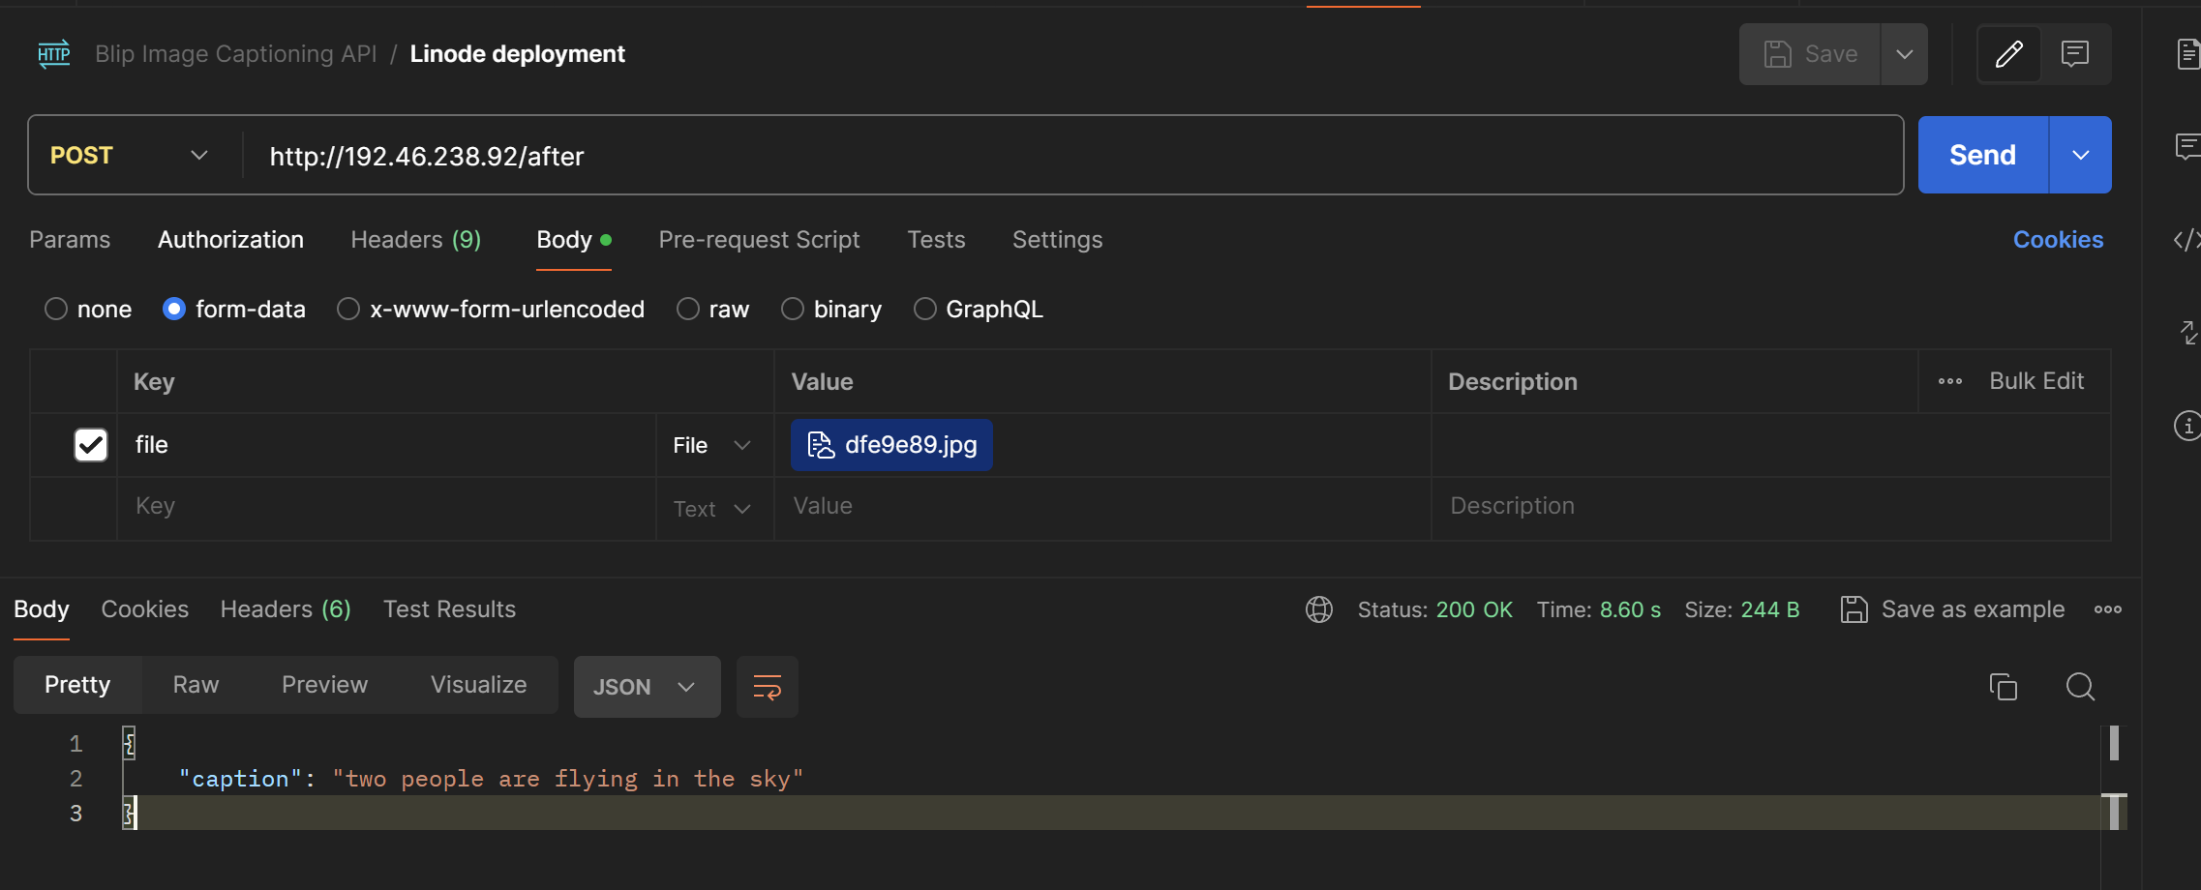
Server
Notes:
"This slide demonstrates the server-side functionality of our application.
Server Endpoint:
The screenshot shows a POST request to our Blip Image Captioning API deployed on Linode. This endpoint processes images and returns descriptive captions.
Request Details:
We use a form-data format to upload an image file. The server processes the image and generates a caption as shown in the JSON response.
Response:
The response includes a caption for the uploaded image, demonstrating the server's ability to handle image processing tasks effectively. The '200 OK' status indicates a successful operation.
By ensuring our server handles requests efficiently and accurately, we provide a reliable backend service that powers our application's core functionalities."

Slide 20
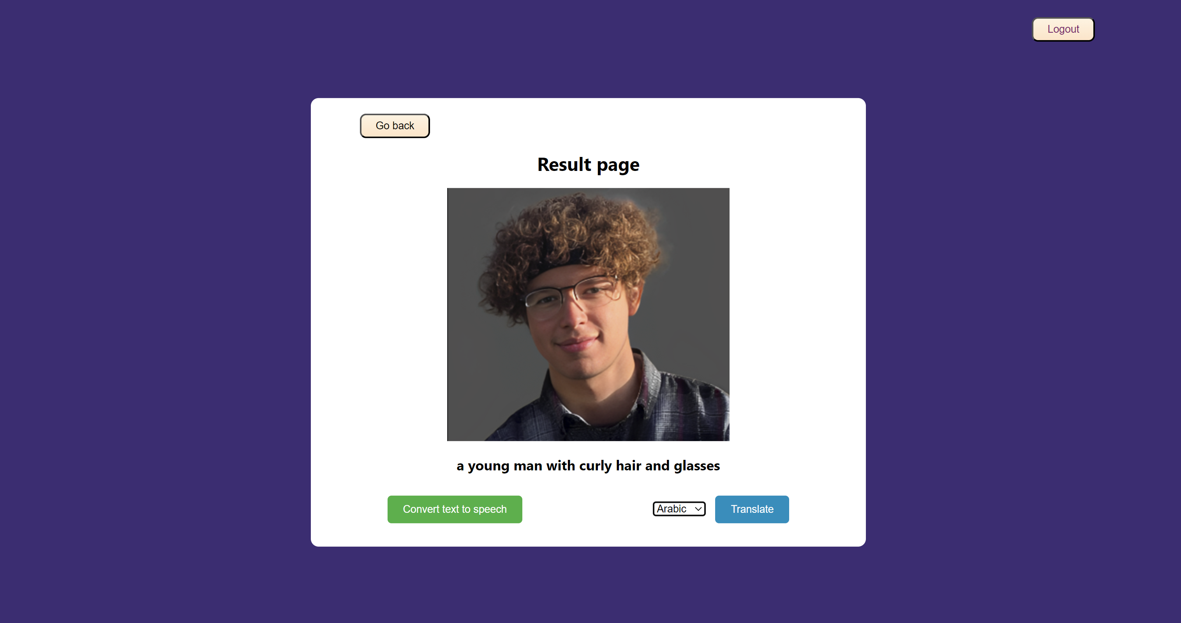
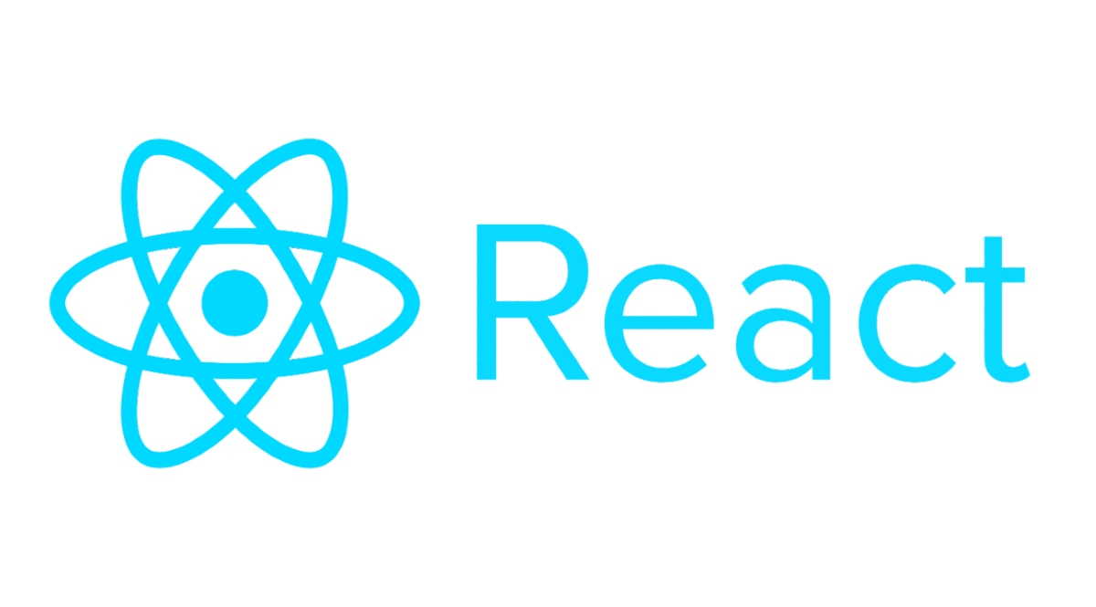
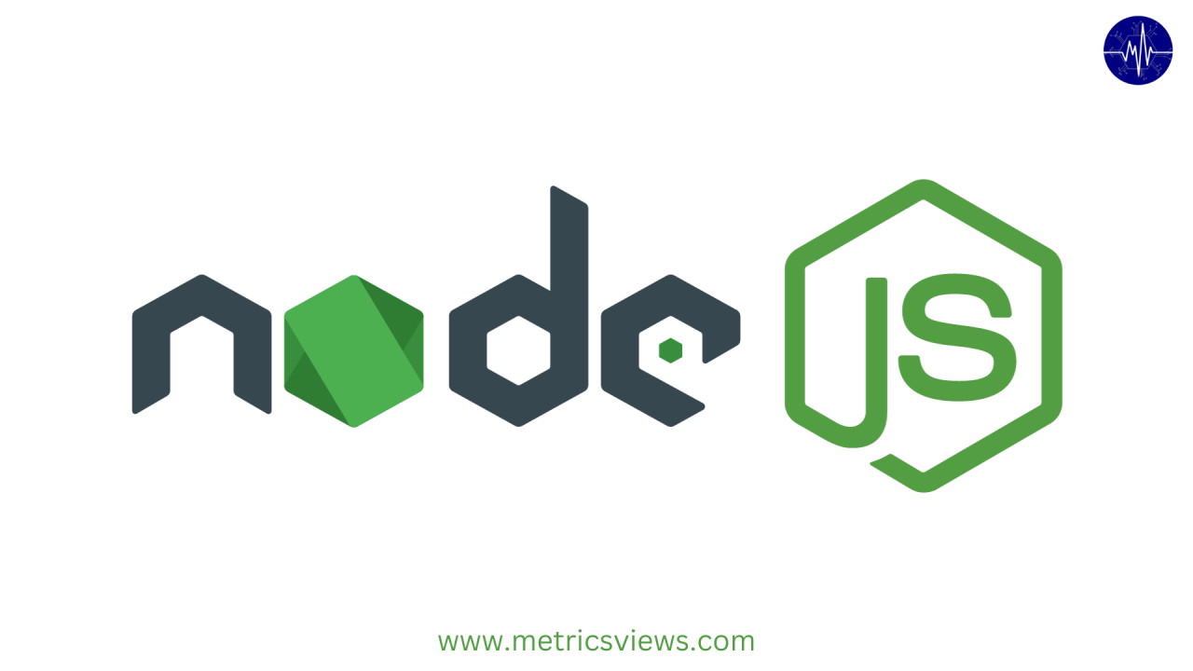
Client + demo

Slide 21


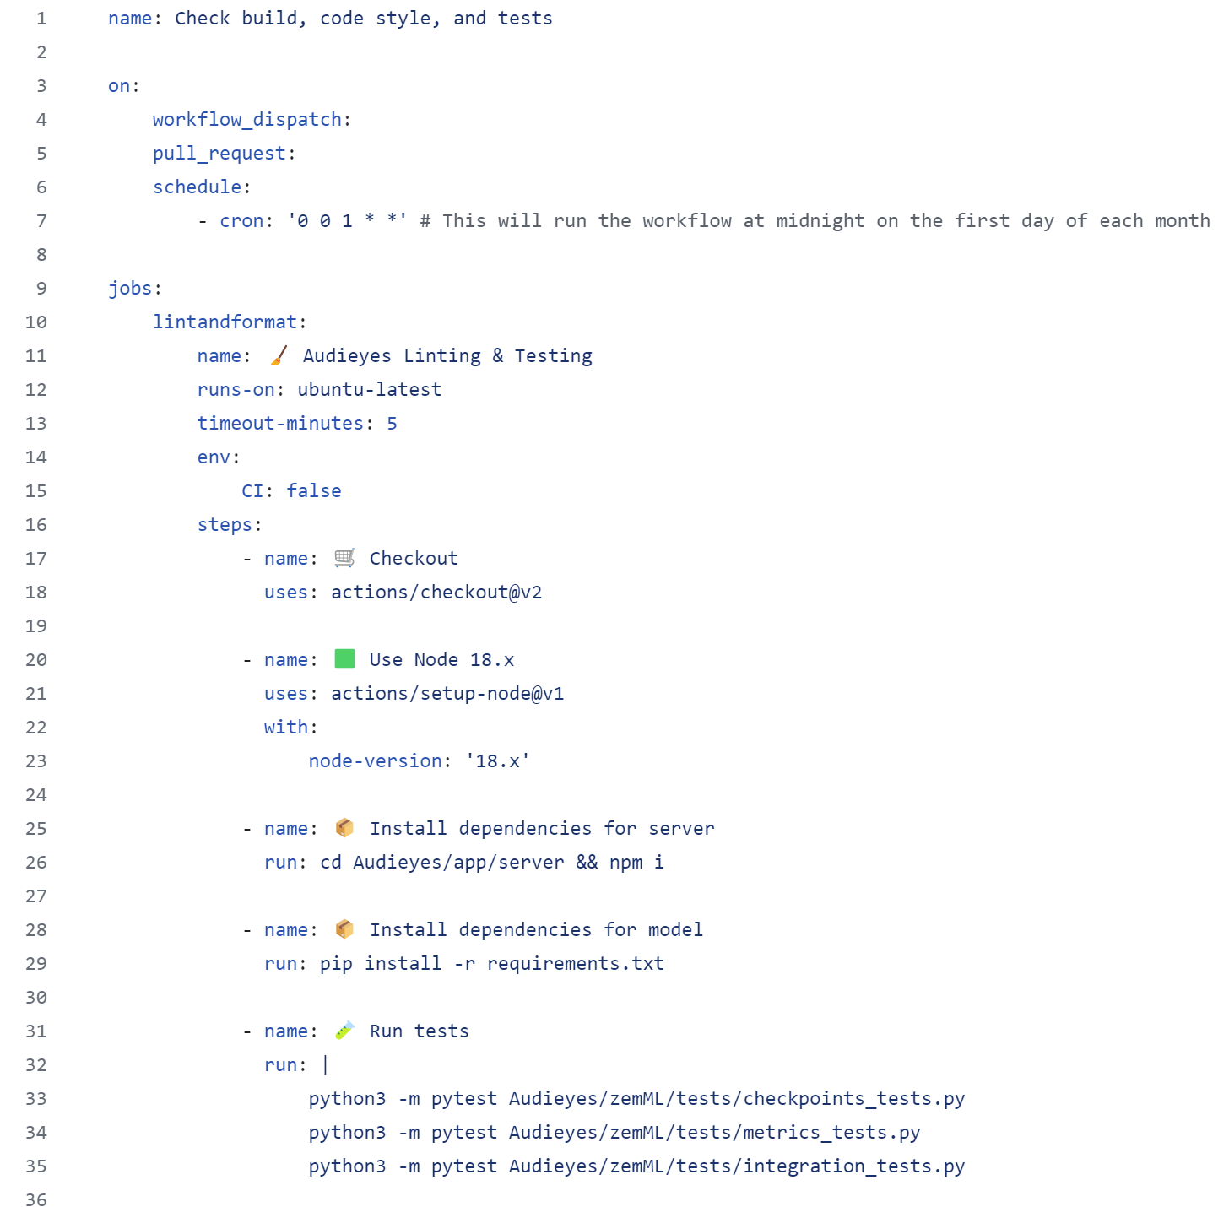
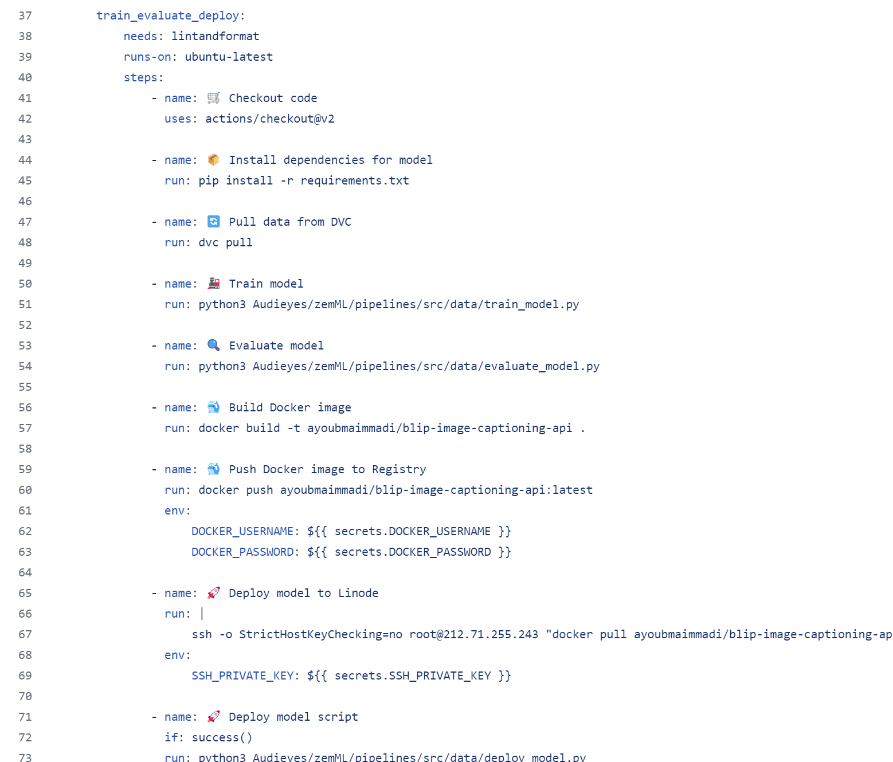
CI/CT/CD pipeline
Notes:
"This slide outlines our continuous integration, continuous testing, and continuous deployment (CI/CT/CD) pipeline, leveraging GitHub Actions and Apache Airflow.
GitHub Actions:
GitHub Actions automates our CI process, including linting, testing, and dependency installation. The workflow ensures code quality and prepares the environment for model training and evaluation.
Apache Airflow:
Apache Airflow orchestrates our end-to-end ML pipeline, from training to deployment. The steps include checking out code, installing dependencies, training and evaluating models, building and pushing Docker images, and finally deploying the model to our production environment.
Pipeline Workflow:
The left section details linting and testing steps, ensuring our codebase is clean and functional.
The right section covers the model lifecycle, including training, evaluation, containerization, and deployment, ensuring our models are continuously updated and deployed seamlessly.
By integrating GitHub Actions and Apache Airflow, we maintain an efficient, automated pipeline that enhances our development workflow and accelerates deployment."

Slide 22
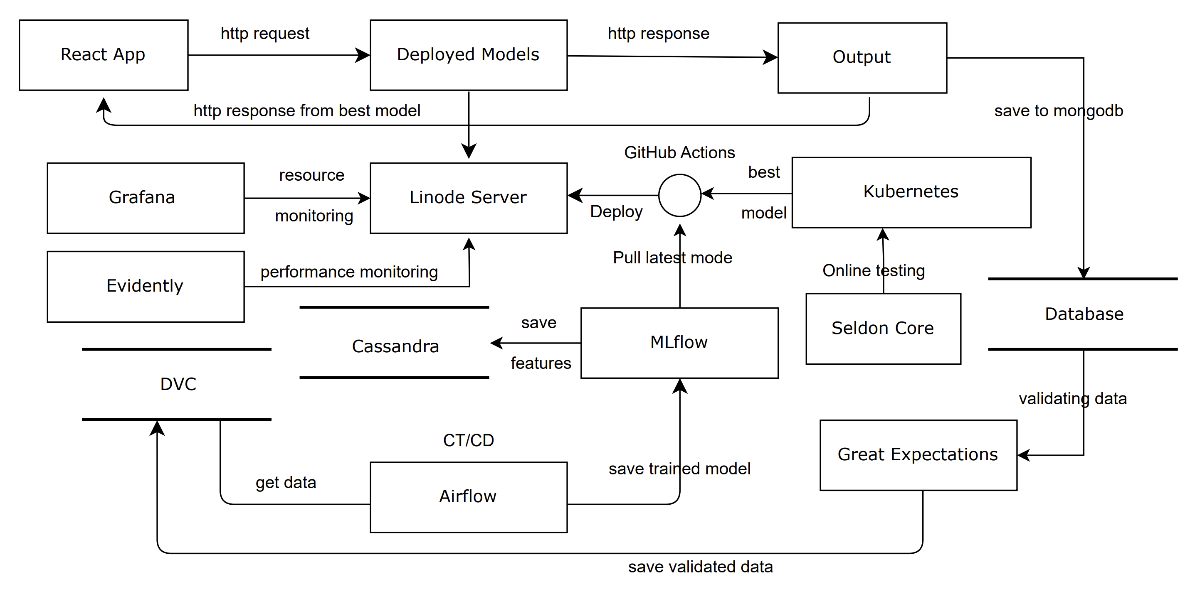
ML system Architecture

Slide 23
Thank you

Slide 24
Responsible AI
Evaluation Beyond Accuracy
Ensuring fairness and transparency
Notes:
Auditing for Bias: "We proactively audit our AI models for bias. This includes analyzing our training data for diversity, using statistical methods to check fairness across different demographics, and involving independent audits to ensure objectivity."
Ensuring Fairness and Transparency: "To guarantee fairness, we implement algorithms designed to make equitable decisions. For transparency, we use interpretable AI techniques, allowing us to explain our model's decisions clearly. This ensures our users and stakeholders understand and trust how our technology works."
Continuous Improvement: "We are committed to continual improvement, regularly updating our models based on new insights and feedback to meet and exceed ethical standards. This ongoing process ensures that Audieyes remains effective and fair."

